Slide 1
Careers That Serve
Recruitment/
Referral Source
Build
The Pool
Instruction/
Apprenticeship
Employment
Jobtimize Sorts the Pool
Identify the people best suited to
target occupations in Culinary, Hospitality, Foodservice
People qualified
to work now
Those who are qualified, directly move into employment
High Schools
Ready to Work
People who are ‘work ready’ skip the Instruction/Apprenticeship column.
Marketing Outreach
Local Workforce Boards, Equus
Dallas College
Stream people into programs for which they are best suited, to prepare them for careers in Culinary Arts, Hospitality and Foodservice.
Those best suited to Culinary Arts
Displaced Workers and Under-employed People
Those best suited to
Hotels & Lodging
Those best suited
to Restaurants
& Foodservice
Dallas College Students
What else is there?
Safety net to catch and re-direct those not well-suited for these careers/industries, into other Dallas College programs.
Other
Sources
Move on to employment
in the appropriate industry
Incumbent Workers
Jobtimize Identifies Talent and Potential in Industry Careers
Identify the people best suited
for training/advancement
Advancement
Those best suited for advancement opportunities at their employer.
Participating
Employers
Notes:
Script/slide build:
In One Workforce project, we will be working with two primary populations:
Displaced workers who will be fed into the program by referral partners in the community, such as Dallas Workforce, community agencies and others; and
Incumbent workers who will be introduced for upskilling opportunities by their employer.
<Advance>
Working with the pool of displaced workers, our first task will be to identify those best suited for the upskilling initiatives we are making available..
<Advance>
We will rely on Jobtimize™ to identify those people who are best suited to jobs in three specific industry verticals – IT and Cyber Security; Advanced Manufacturing and Robotics, and Transportation.
<Advance>
Dallas College will provide each with the instruction they need to qualify for those in-demand, future-friendly occupations.
<Advance>
Those who are not well suited to those occupations will be presented with a career planning report that will select their top picks from a library of 1300 other occupations, and our Workforce partners will support them accordingly to find the right training or employment opportunities.
<Advance>
On the Incumbent Workers side of things, Jobtimize™ will be used by participating employers to survey their existing employee base and
<Advance>
identify those who are best suited to being trained for enhanced roles in the organization.
<Advance>
Once again, Dallas College will deliver the training to equip those employees with advanced skills they will bring back to their employer.

Slide 2
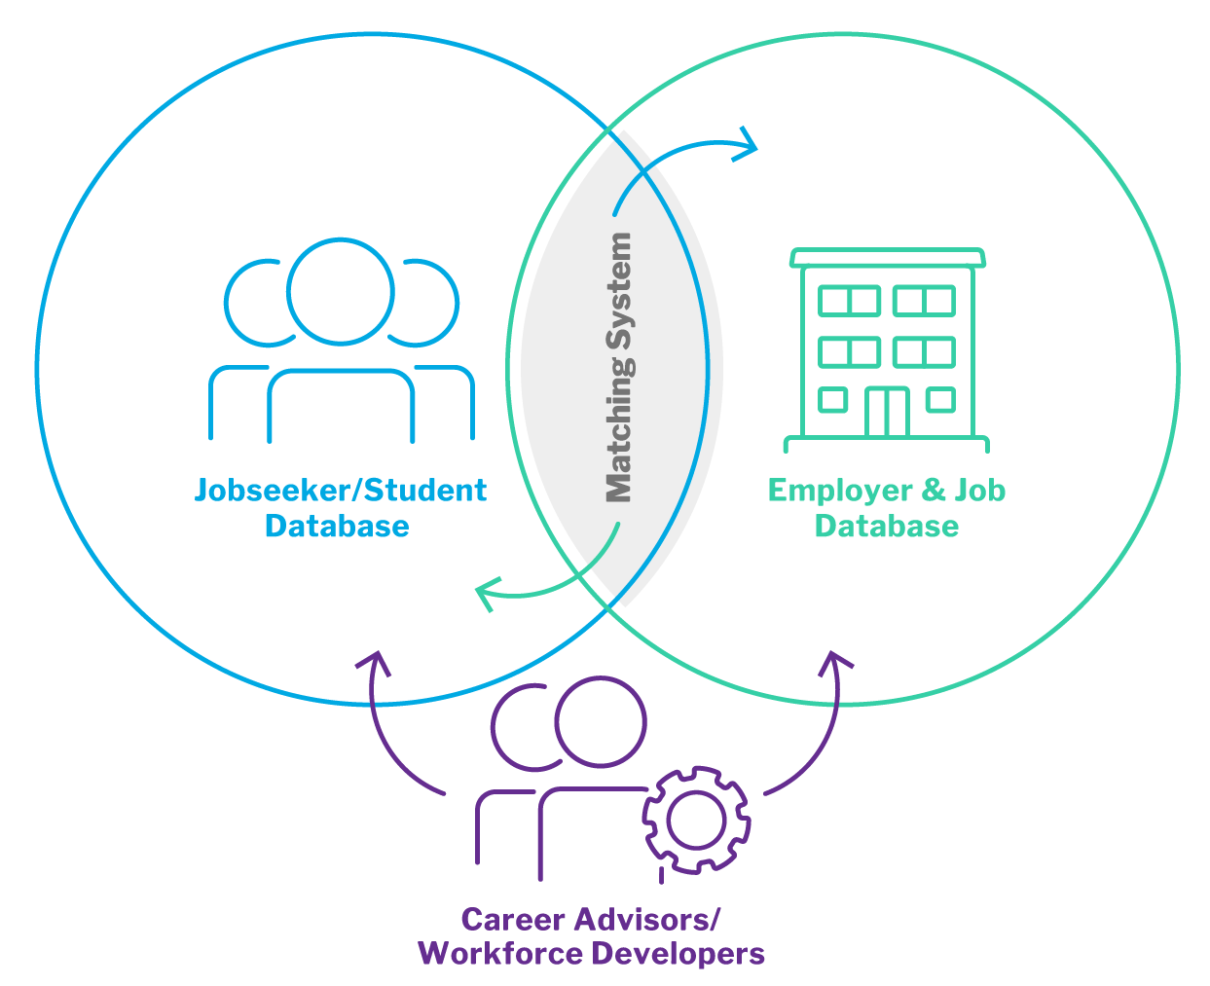


Careers That Serve – Jobtimize Powers a Person-Centric Employment System
Jobseekers/Students
Employers
Behavioral algorithms identify the occupations/roles to which the person is naturally best suited. The focus is on fit and potential, not pedigree.
These same algorithms identify the individuals who are naturally best suited to the reality that awaits them, across the four critical aspects of fit – manager, job, team and culture.
“Aptitude is evenly distributed in the general population; Opportunity is not.”
Notes:
What makes Jobtimize® unique is some very sophisticated technology packed into a job-matching engine that is designed to work in both directions –
It helps people understand the careers or occupations which are naturally the best fit for them, based on their own behavioral profile. It leads with who you are, not ‘what you know’. A little like eHarmony for work.
For employers, there’s a really useful twist – rather than looking for people with the right ‘pedigree’ in terms of previous work experience, the system is geared instead to help them find the right people in the applicant pool – people who are likeliest to fit in their environment, who have the necessary soft skills, attitudes, and standards, and who have the ability to learn the necessary job skills. People have been talking about hiring for attitude and training skills for a long tie, finally here’s a system that allows you to do exactly that.
On of Jobtimize® ’s clients actually coined the phrase at the bottom of the slide – Aptitude is evenly distributed in the general population; opportunity is not. And when you think about it, the information in a resume is nothing more than a reflection of the opportunity someone has been given until now, in the form of access to skills, to meaningful education, to employment opportunities, to networks and mentors – all formidable barriers to many of the people we will be serving through the One Workforce Project.
Fundamentally, Jobtimize® helps you find great people, in surprising packages. Our job is to give them the necessary training to be job-ready.

